Slide 1
Back Tracking
Presented By:Er.Sudan Prajapati

Slide 2
Introduction
Backtracking is basically a form of searching.
Prolog has built in backtracking mechanism.
It tries to prove a goal with all possible instantiations.
Automatic backtracking is a useful programming concept because it reveals the programmer of the burden of backtracking.

Slide 3
suppose that the Prolog interpreter is trying to satisfy a sequence of goals(goal_1, goal_2).
When the Prolog interpreter finds a set of variable bindings which allow goal_1 to be satisfied, it commits itself to those bindings, and then seeks to satisfy goal_2.
Eventually one of two things happens:
(a) goal_2 is satisfied and finished with;
or
(b) goal_2 cannot be satisfied. In either case, Prolog backtracks.
That is, it "un-commits" itself to the variable bindings it made in satisfying goal_1 and goes looking for a different set of variable bindings that allow goal_1 to be satisfied.

Slide 4
Task
Facts
Bimala is a female
Lina is a female
Mita is a female.
Nitu is a female.
Pretty is a female.
Puran is a male.
Bikram is a male.
Fran is a male.
Bimala is apparent of Bikram.
Puran is parent of Bikram.

Slide 5
Bimala is parent of Lina.
Puran is parent of Lina.
Bimala is parent of Mita.
Puran is parent of Mita.
Nitu is parent of Pretty.
Fran is parent of Pretty.
Rule
X is Father of Y if and only if X is parent of Y and X is Male.

Slide 6
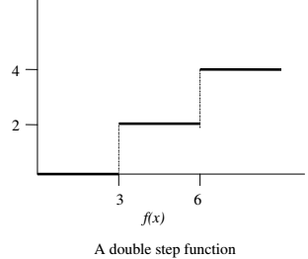
Task
Consider a function shown in the figure below. The relation between X and Y can be specified by the following three rules.
Rule 1: if X<3 then Y=0
Rule 2: if 3=<X <6 then Y=2
Rule 3: if 6<X then Y=4

Slide 7
Goal
f(1,Y)
f(1,Y), 2<Y.
Here in case f(1,Y) becomes instantiated to 0 and the second goal becomes 2 < 0 which fails whole goal list.
Before admitting the goal Prolog tries through backtracking 2 useless alternatives .

Slide 8
CUT
Up to this point, we have worked with Prolog's backtracking execution behavior.
We have seen how to use that behavior to write compact predicates.
Sometimes it is desirable to selectively turn off backtracking.
Prolog provides a predicate that performs this function. It is called the cut, represented by an exclamation point (!).
The cut effectively tells Prolog to freeze all the decisions made so far in this predicate. That is, if required to backtrack, it will automatically fail without trying other alternatives.

Slide 9
Example
a(1).
b(1).
c(1).
b(2).
c(2).
d(2).
e(2).
f(3).

Slide 10
p(X) :- a(X).
p(X) :- b(X),c(X),d(X),e(X).
p(X) :- f(X).
Goal
p(X).

Slide 11
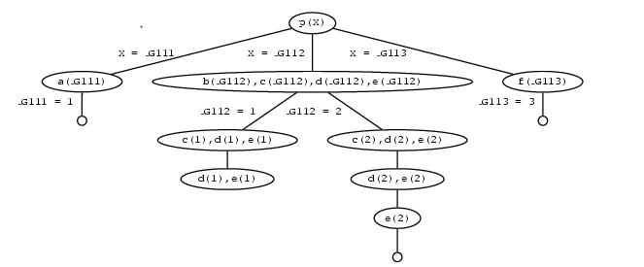
Search Tree

Slide 12
Edit Rule (insert Cut in the statement)
p(X) :- b(X),c(X),!,d(X),e(X).
Goal
p(X).

Slide 13
p(X) is first matched with the first rule, so we get a new goal a(X). By instantiating X to 1, Prolog matches a(X) with the fact a(1) and we have found a solution. So far, this is exactly what happened in the first version of the program.
We then go on and look for a second solution. p(X) is matched with the second rule, so we get the new goals b(X),c(X),!,d(X),e(X).
By instantiating X to 1, Prolog matches b(X) with the fact b(1), so we now have the goals c(1),!,d(1),e(1). But c(1) is in the database so this simplifies to !,d(1),e(1).
The ! goal succeeds (as it always does) and commits us to all the choices we have made so far. In particular, we are committed to having X = 1, and we are also committed to using the second rule.

Slide 14
But d(1) fails. And there's no way we can resatisfy the goal p(X).
Sure, if we were allowed to try the value X=2 we could use the second rule to generate a solution (that's what happened in the original version of the program). But we can't do this: the cut has committed us to the choice X=1. And sure, if we were allowed to try the third rule, we could generate the solution X=3. But we can't do this: the cut has committed us to using the second rule.

Slide 15
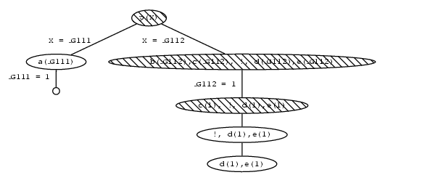

Slide 16
Task
Compute the Maximum Value
Make a rule of following Statement
If X is greater than Y Then maximum value is X otherwise max= Y.
Implement Cut to prevent Back Track.

Slide 17
Double step function (Continue)
Using Cut Make a following rule.
f(X,0) :- X<=3,!.
f(X,2) :- 3=< X,X<6 ,!.
f(X,4) :-6=< X.
Goal
f(1,Y),2<Y.

Slide 18
Perform the following
f(10,Y)
The result will be
Y=4
Rule1: 10 < 3 fails, backtrack tries rule 2(cut was not reached)
Rule 2:3<=10 succeed but 10<6 fails ,backtrack and try rule 3
Rule 3: 6<=10 succeed.
Do you think its efficient ??

Slide 19
Make a new Rule
IF X< 3 then Y=0,
Otherwise IF X < 6 then Y=2,
Otherwise Y=4

Slide 20
Example
Facts and Rules
member(X, [X | Rest]). % X is a member if its the first element
member(X, [Y | Rest]) :- member(X, Rest). % otherwise, check if X is in the Rest
Goals
member(X, [a, b, c]).
member(a, [a, a, a]).
TASK
Use CUT

Slide 21
Adding element to List
Rules
add(X,L,L) :- member(X,L),!.
Add(X,L,[X|L]).
Goal
add(a,[b,c],L).
add(X,[b,c],L).
add(a,[b,c,X] ,L).
add(a,[a,b,c],L).

Slide 22
Length of List
list_length([],0).
list_length([_|T],L):-list_length(T,L1),L is L1+1.
Goal
list_length([d,e,e,r,w,a,l,k,I,n,s,t,I,t,u,e,],L).

Slide 23
Assignment
Write a Prolog program to Find LCM.
Write a prolog program to reverse List items.
Write a prolog program to check palindrome.

Slide 24
Using not for inequality
Prolog has a not operator, but its behaviour is more subtle than in other languages.
Example:
Facts
crispy(snap).
crispy(crackle).
crispy(pop).
Rule
breakfast(A,B,C) :- crispy(A), crispy(B), crispy(C).
Goal
?- breakfast(A,B,C).

Slide 25
Modify
breakfast(A,B,C) :- crispy(A), crispy(B), crispy(C), not(A=B), not(A=C), not(B=C).

Slide 26
Negation
Prolog assumes that if it can't prove an assertion, then the assertion is false.
And Prolog assumes that if it can prove an assertion, then the assertion is true.
This is the "closed world assumption": in the universe of facts Prolog knows about, failure to prove is proof of failure.
But if we know something Prolog doesn't, this can lead to surprises: things that Prolog thinks are false when we know they're true, and the opposite.
Example:
university(uoft).
?- university(york).
\+ university(york).

Slide 27
Example
sad(X) :- \+ happy(X).
happy(X) :- beautiful(X), rich(X). rich(bill).
beautiful(michael). rich(michael). beautiful(cinderella).
?- sad(bill).
?- sad(cinderlla).

Slide 28
Example
color(red).
color(orange).
color(yellow).
color(green).
color( blue).
color(purple).
color(black).
color(brown).
color(gold).
muddcolor(black).
muddcolor(gold).

Slide 29
awesomescolor(X,Y):-muddcolor(X),muddcolor(Y),
X\==Y.
checkInequlaityEarly(X,Y):-X\==Y,muddcolor(X),muddcolor(Y).
notmuddcolorbroken(X):- not(muddcolor(X)).
notmuddcolor(X):-color(X),not(muddcolor(X)).

